Slide 1

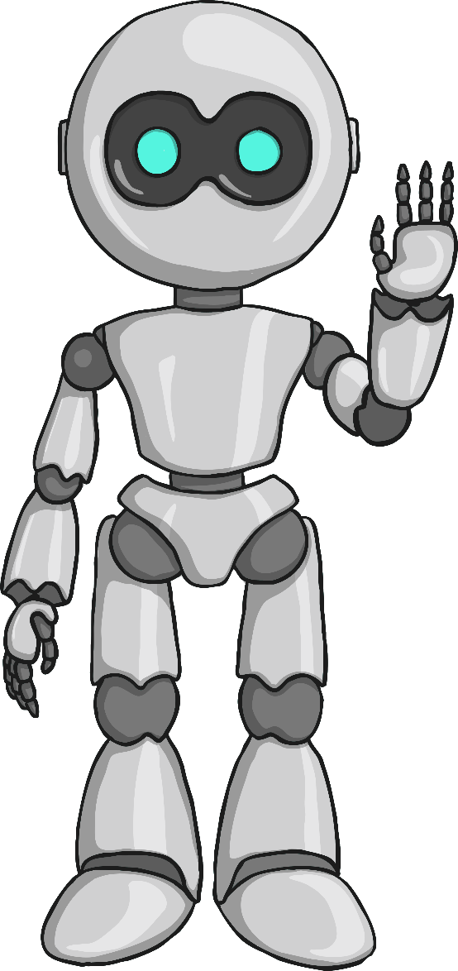



AI/ML Driven Low Latency Closed Loop Control
IIT-Bhilai
IIT-Delhi
ITU
Team Members(AI_ML_SSD)
Dr. Sk Subidh Ali
Professor(Mentor)
IIT Bhilai
Mr. Debanka Giri
Project Scientist
IIT Delhi
Mr. Sudev Kumar Padhi
Research Scholar
IIT Bhilai
Mr. Mohit Kumar
B.Tech Student
IIT Bhilai

Slide 2

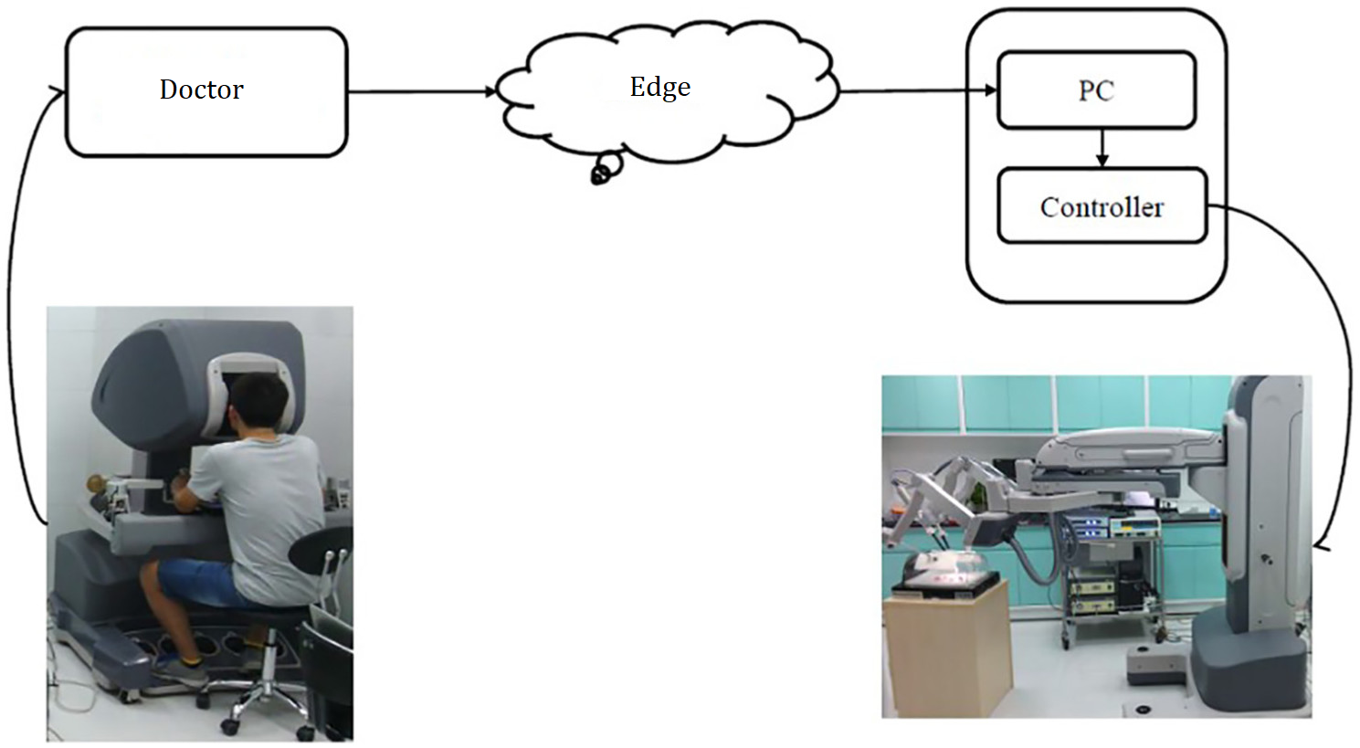

Introduction
Introduction
Closed Loop Control
Tele Surgery, Remote area installation
Tele Surgery With increasing advancements
in Virtual reality and Haptic gloves, its uses
in operating robotic hand remotely is increasing.
But Achieving human level robustness in Robotic manipulation has long been a challenging problem in the robotic community.

Slide 3


Problem Statement
Problem Statement - I: (Slip Detection & Force Estimation)
Overall this task requires an estimation of the force to be applied on the object for a successful grasp.
Leverage latency-aware learning technique to -
Find if the object is about to slip.
Find if the object is about to crumple.
Problem Statement - II: (Object Detection)
The Robotic Hand records its current states (in the form of angular configuration and forces exerted on its joints).
Using this modality the task is to detect the shape of the object.
In future we will apply the appropriate control to prevent the slip.

Slide 4
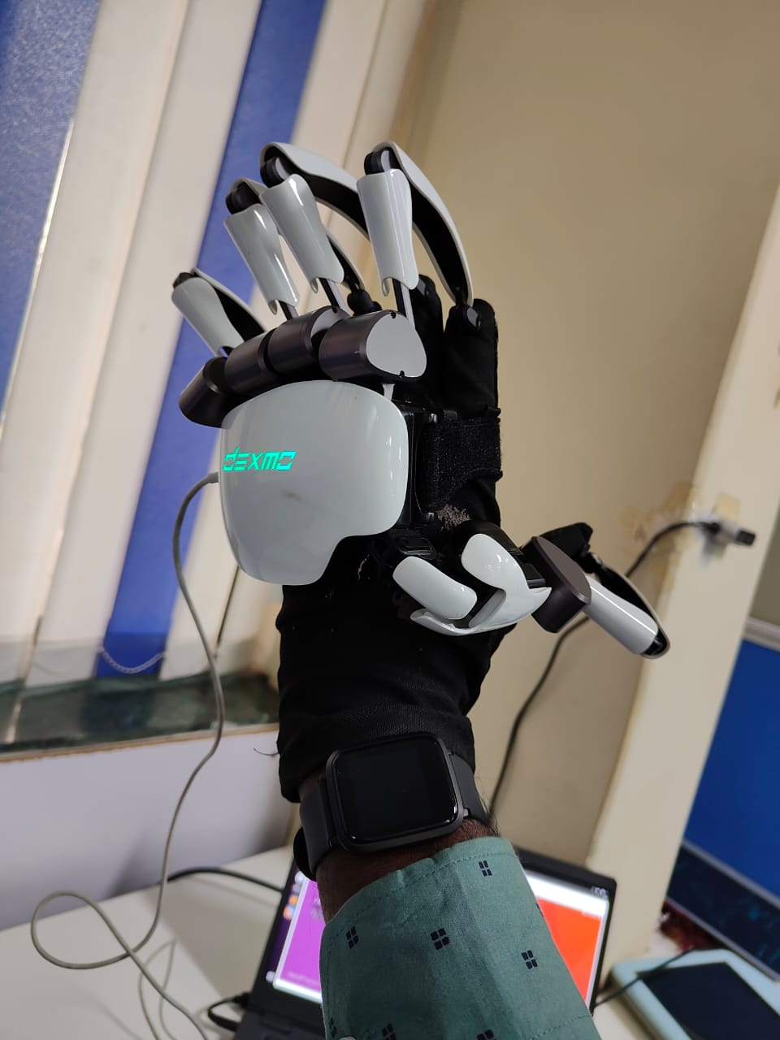
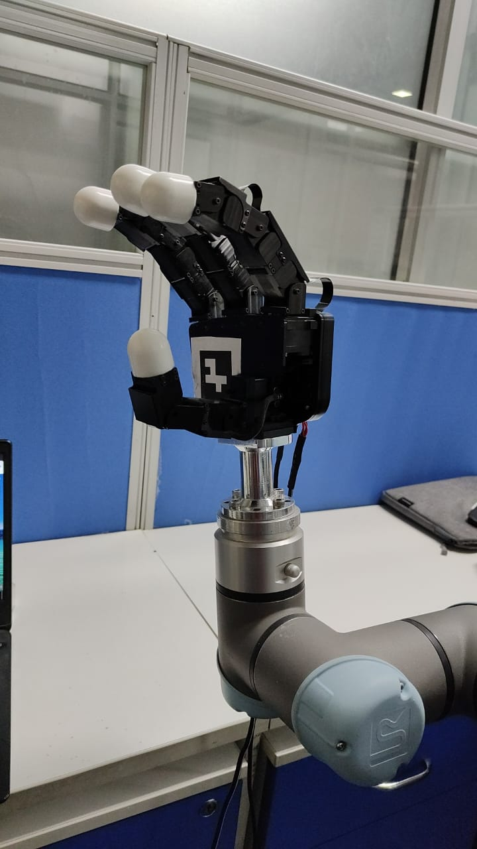
Haptic Glove
Robotic hand

Slide 5
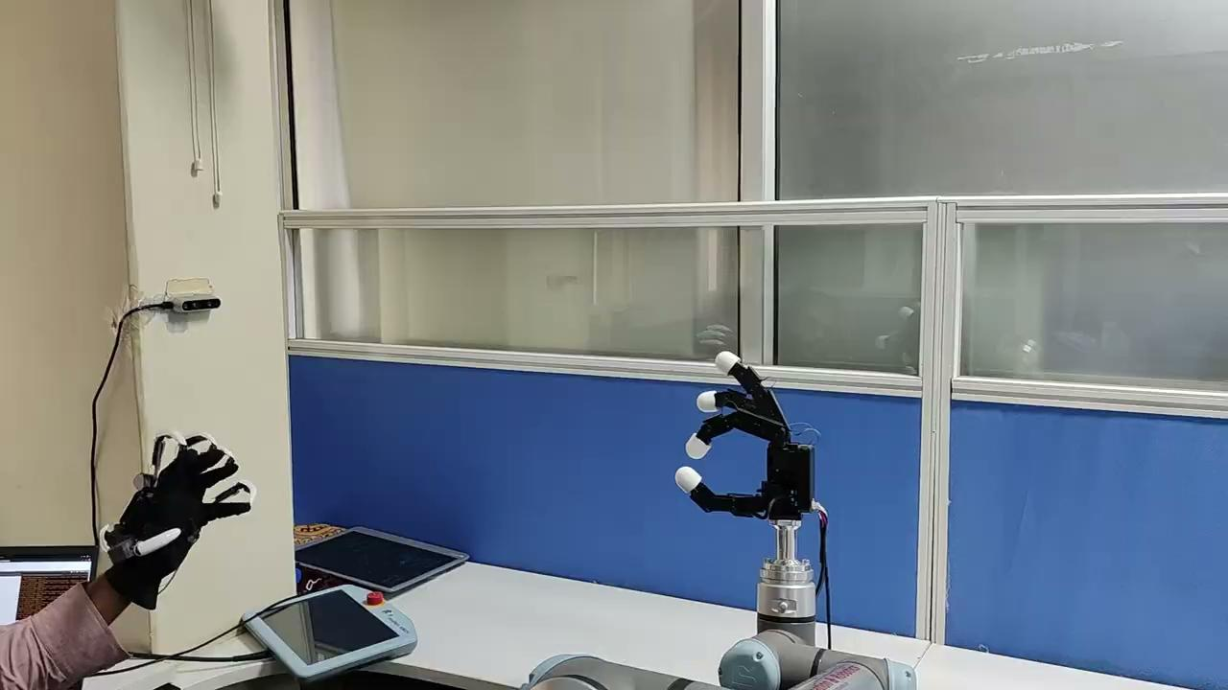

Slide 6
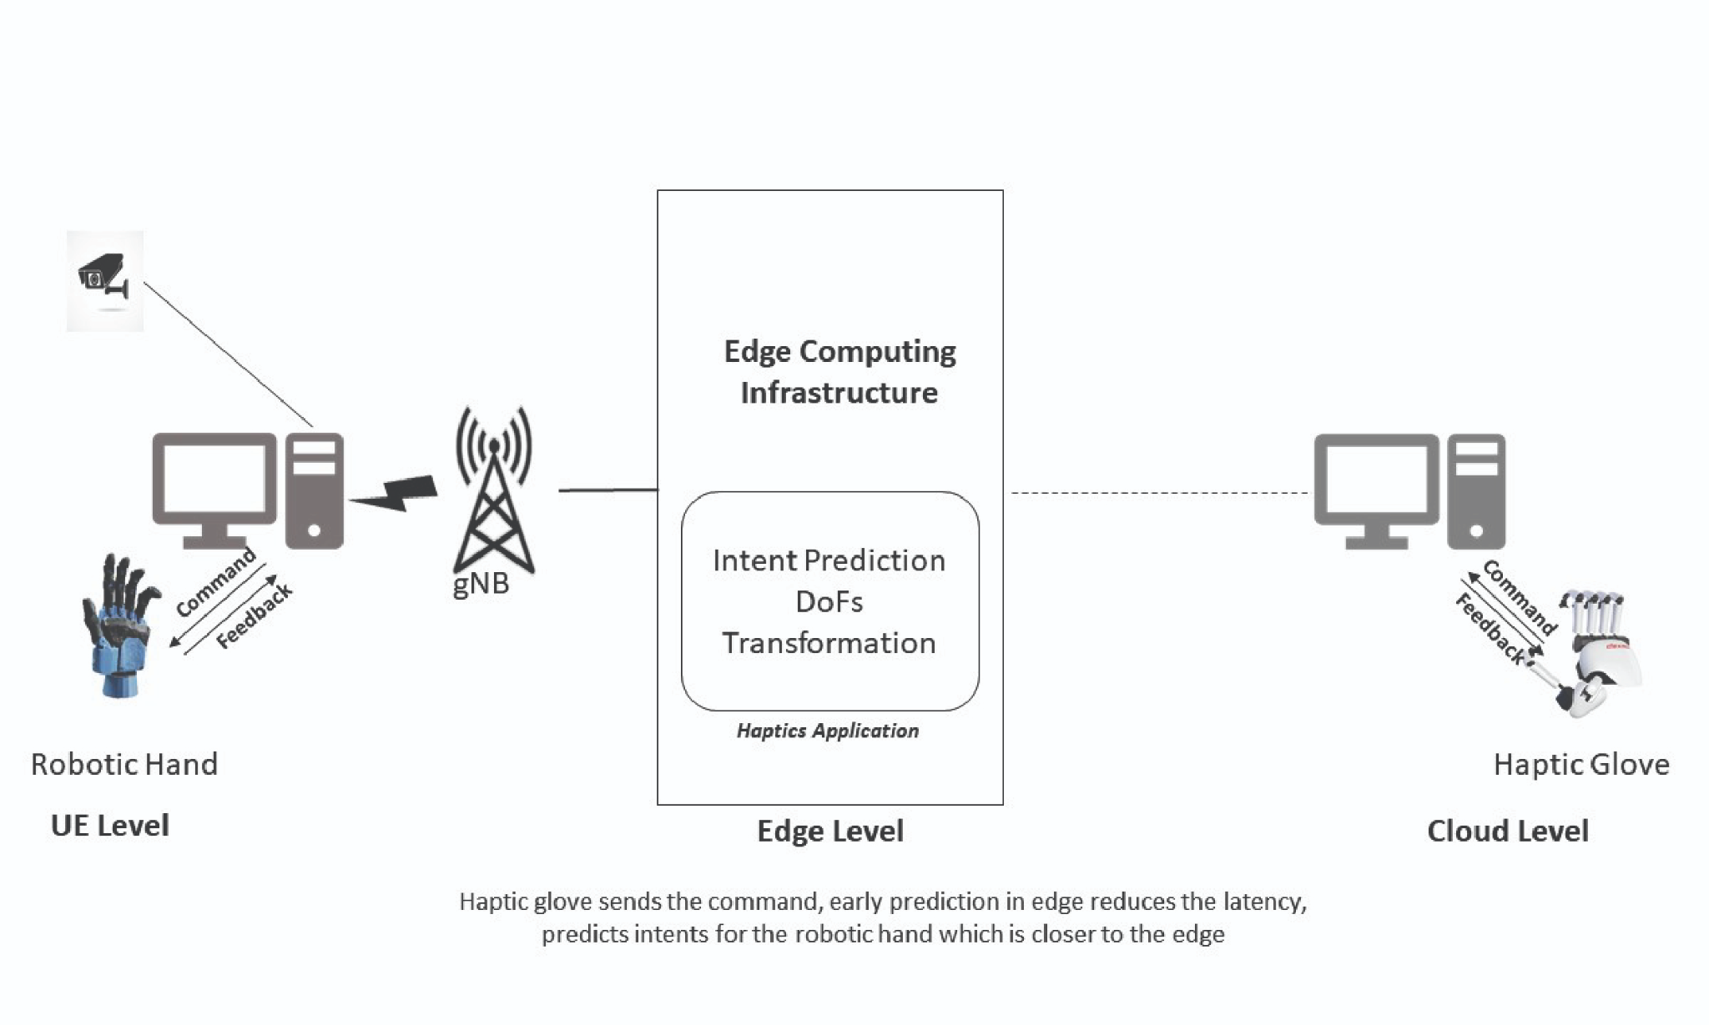
Haptics technology

Slide 7
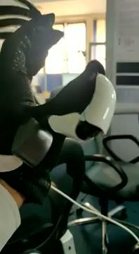
Criticality
High-Latency in the loop.
Requires a proficient operator.
Slip and crumple detection.
Robustness in manipulation tasks.

Slide 8
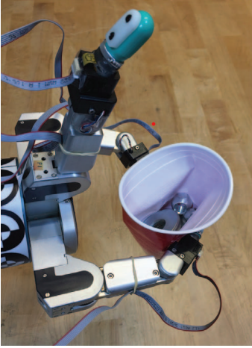
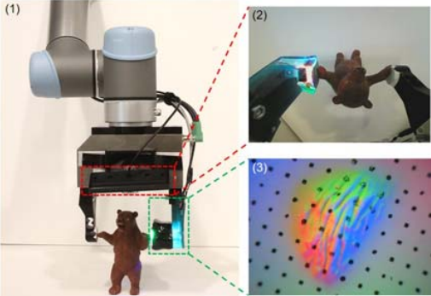
State of the art
Slip Detection/Classification for grip control using a biomimetic tactile sensor.
Slip Detection with Combined Tactile and Visual Information.
Slip Detection with Combined Inertial(accelerometers) and
Visual Information.

Slide 9
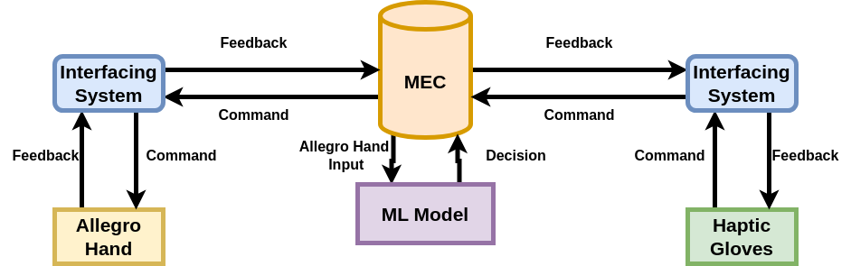
Our Solution in closed loop
ML model can solve our problem.

Slide 10
Problem Statement -1: Slip Detection and Force Estimation
Problem Statement : I
Given an object being held by an Allegro Hand. The object may tend to slip or crumple from the grip
Our aim is to predict if the object is slipping and Crumpling using ML models.
Inputs:
Force and angle made by the sixteen actuators of the allegro hand with the object.
Mass and the shape of the object.
Outputs:
Values for slip and crumple.
Action | Yes | No
Slip | 1 | 0
Crumple | 1 | 0

Slide 11
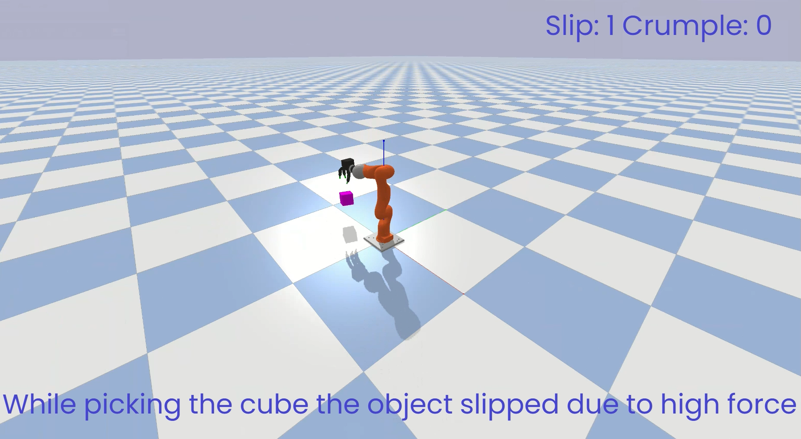
What is slipping ?

Slide 12
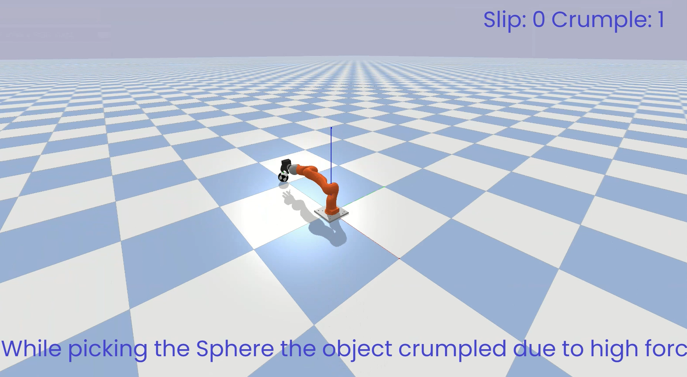
What is crumpling ?

Slide 13
Problem Statement -2: Object Detection
Problem Statement : II
The object is currently held by an Allegro hand.
Our aim is to predict the shape of the object from 13 different shapes using an ML model.
Inputs:
Force and angle made by the sixteen actuators of the allegro hand with the object.
Mass of the object.
Outputs:
Shape of the object which is being held.
The shape of the object could be a sphere, cube, or cuboid with different dimensions.

Slide 14
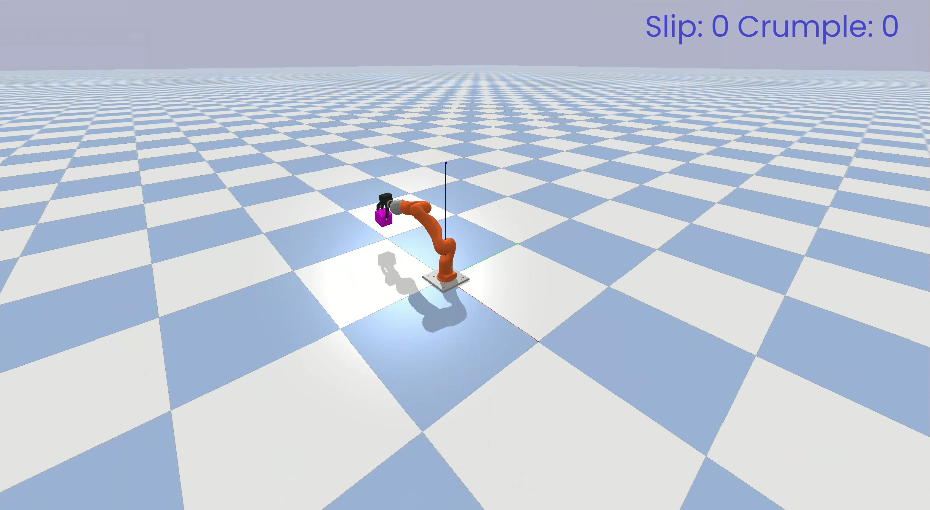
Shape Detection of Cube

Slide 15
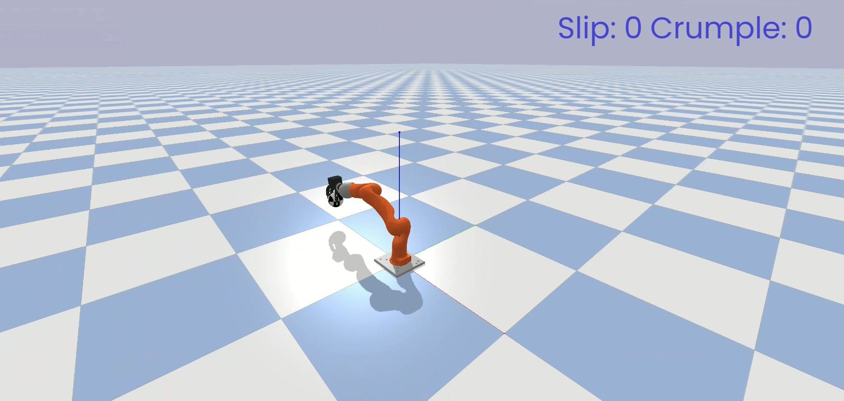
Shape Detection of Sphere

Slide 16
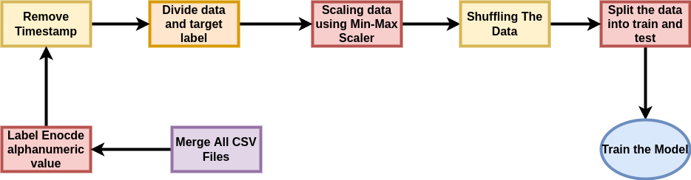
Design
Problem statement I: (Slip Detection and Force Estimation)
Timestamp data was given to predict slip and crumple.

Slide 17
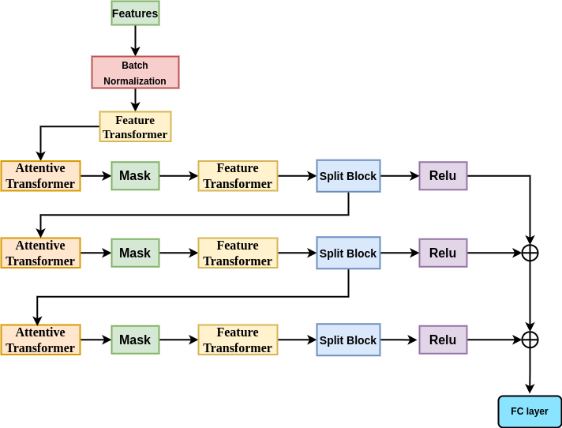
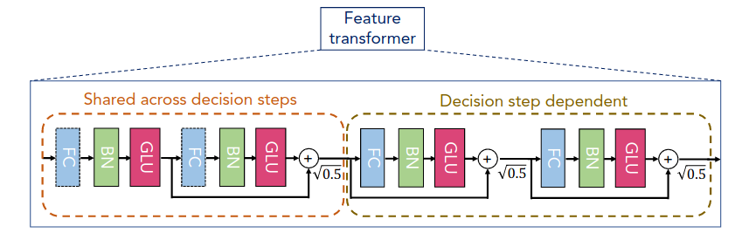
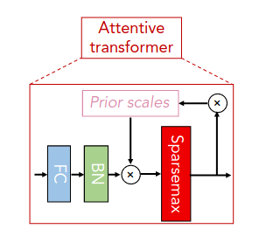
Experimental Methodologies

Slide 18
Hyperparameter Space
Framework used | Pytorch
Learning rate | 0.02
Optimizer | Adam
Loss Function | Cross Entropy
Momentum | 0.02
Model Type | Deep Neural Network
Epochs | 100
Validation Split | 0.16 percent of whole data
Batch Size | 2048

Slide 19
Comparison
Models | Proposed Model | DNN(10 layers) | DNN(50 layers) | LSTM
Validation accuracy | 93.2 | 86.2 | 88 | 89.4
Training Accuracy | 93.7 | 87 | 89 | 90.1
Loss | 0.13521 | 0.26 | 0.22 | 0.18

Slide 20
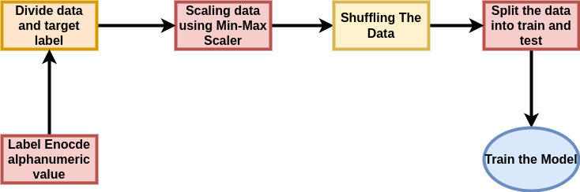
Design - Problem statement II: (Object Detection)

Slide 21
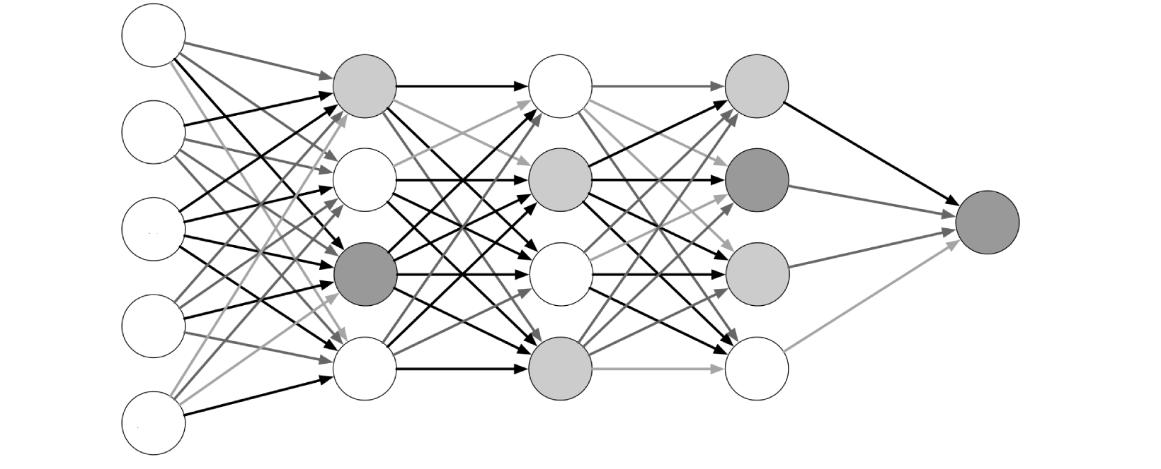
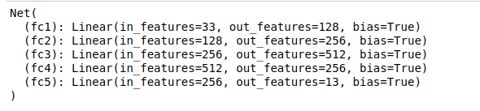
Experimental Methodologies

Slide 22
Hyperparameter Space
Framework used | Pytorch
Learning rate | 0.002
Optimizer | Adam
Loss Function | Cross Entropy
Momentum | 0.02
Model Type | Deep Neural Network
Epochs | 200
Validation Split | 10 Fold validation
Batch Size | 2048

Slide 23
Comparison
Models | Proposed Model | DNN(15 layers) | DNN(10 layers) | LSTM
Validation accuracy | 99.7 | 99.6 | 98.9 | 94.6
Training Accuracy | 99.8 | 99.8 | 99.2 | 95.4
Loss | 0.014 | 0.019 | 0.024 | 0.05

Slide 24
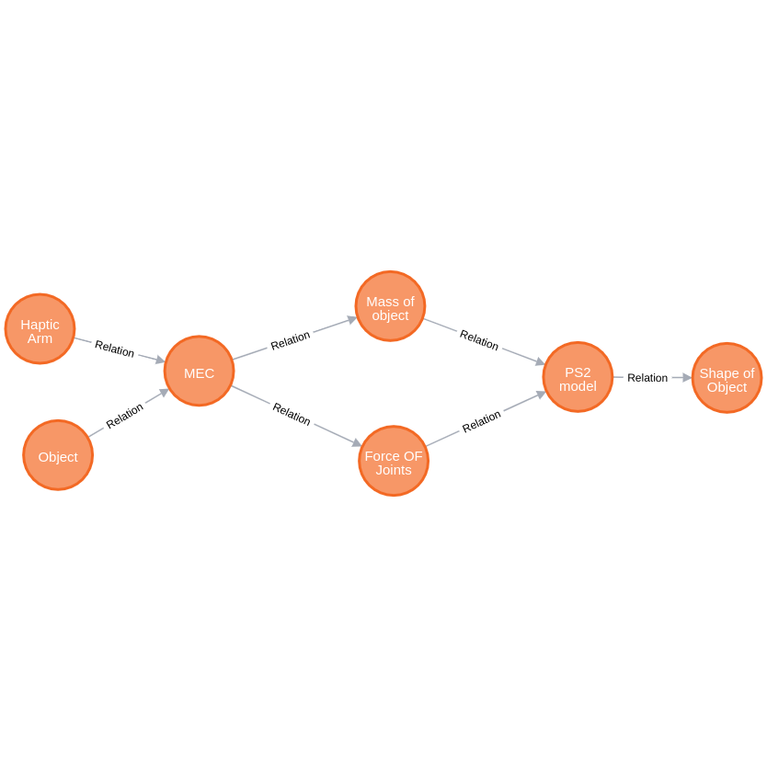
Graph: (Object Detection)

Slide 25
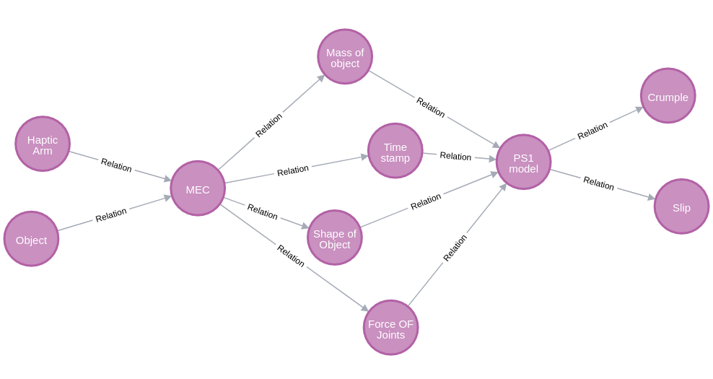
Graph: (Slip Detection and Force Estimation)

Slide 26


